Slide 1
Impact Of Car Features On Price And Profitability

Slide 2
PROJECT DESCRIPTION:
The automotive industry has been rapidly evolving over the past few decades, with a growing focus on fuel efficiency, environmental sustainability, and technological innovation. With increasing competition among manufacturers and a changing consumer landscape, it has become more important than ever to understand the factors that drive consumer demand for cars.
In recent years, there has been a growing trend towards electric and hybrid vehicles and increased interest in alternative fuel sources.At the same time, traditional gasoline-powered cars remain dominant in the market, with varying fuel types and grades available to consumers.
For the given dataset, as a Data Analyst, the client has asked How can a car manufacturer optimize pricing and product development decisions to maximize profitability while meeting consumer demand?.
This problem could be approached by analyzing the relationship between a car's features, market category, and pricing, and identifying which features and categories are most popular among consumers and most profitable for the manufacturer. By using data analysis techniques such as regression analysis and market segmentation, the manufacturer could develop a pricing strategy that balances consumer demand with profitability, and identify which product features to focus on in future product development efforts. This could help the manufacturer improve its competitiveness in the market and increase its profitability over time.

Slide 3
APPROACH :
In this project, I used wps Excel and Tableau to visualize the data.
After reading the data, I performed eda to know the total missing values in each variables.
performed data analysis techniques such as regression analysis, pivot tables, sensitivity analysis, optimization, and time series analysis.
then build an interactive dashboard.
TECK STACK USED:
I have used wps Excel and Tableau Public 2023.2 because wps Excel is a free popular spreadsheet software widely used for data analysis, modeling, and visualization. Tableau public is a free business analytics service that provides interactive visualizations and business intelligence capabilities, and integrates with a wide range of data sources. It allows users to create customized dashboards and reports.

Slide 4
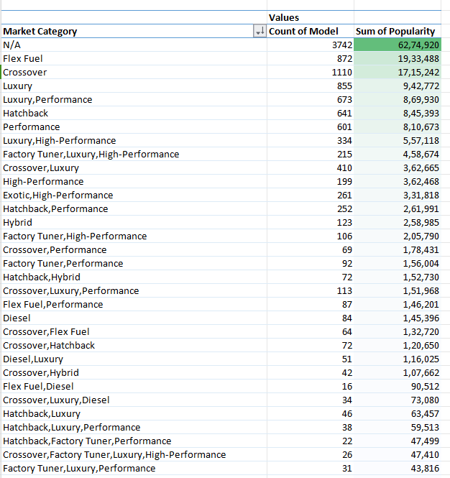
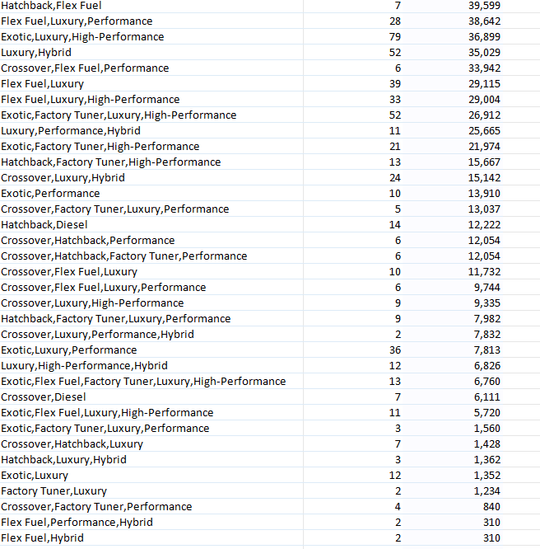
RESULTS AND INSIGHTS :
Insight Required: How does the popularity of a car model vary across different market categories?
Task 1.A: Create a pivot table that shows the number of car models in each market category and their corresponding popularity scores.
Ans:The flex fuel & crossover market category has the highest popularity among customers.

Slide 5
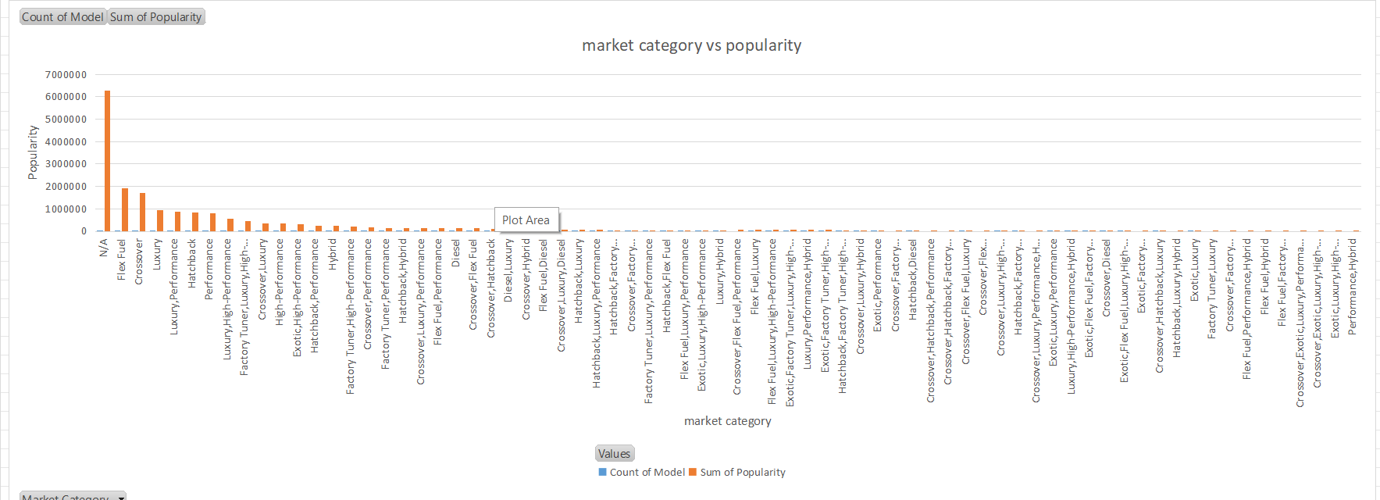
Task 1.B: Create a combo chart that visualizes the relationship between market category and popularity.
Ans:

Slide 6
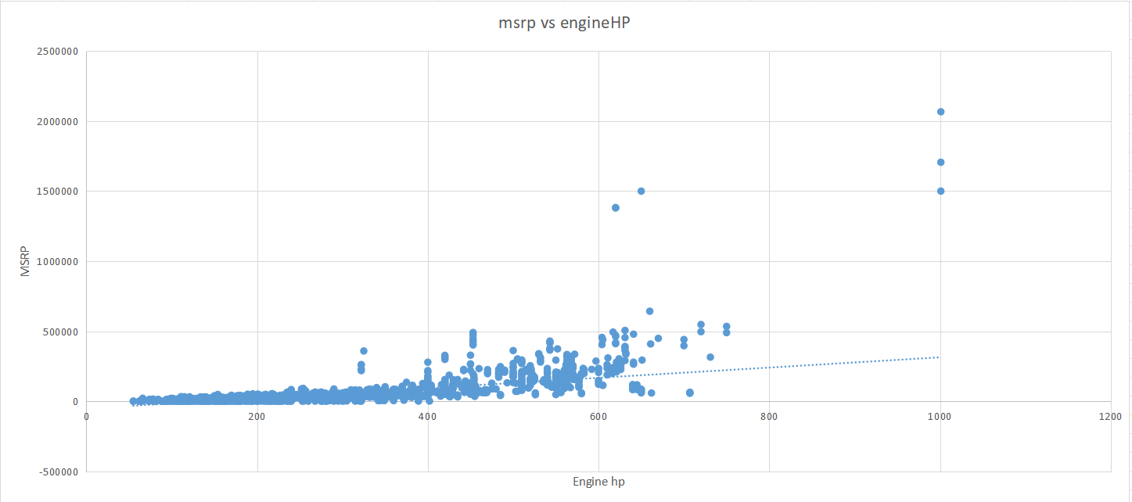
Insight Required: What is the relationship between a car's engine power and its price?
Task 2: Create a scatter chart that plots engine power on the x-axis and price on the y-axis. Add a trendline to the chart to visualize the relationship between these variables.
Ans:There is a positive relationship between a car's engine power and its price, where the price increases as the engine power increases.

Slide 7

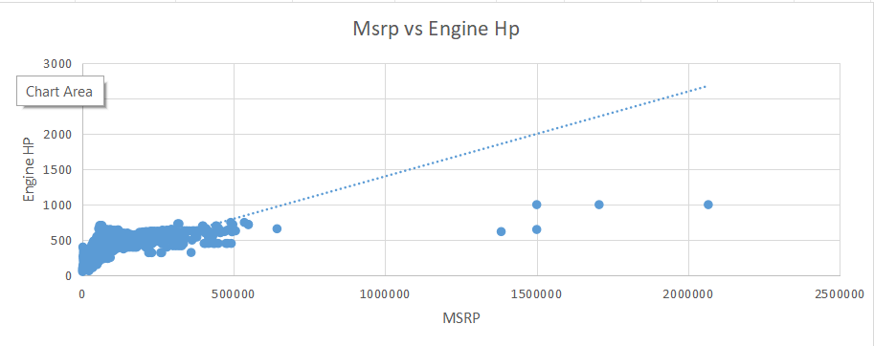
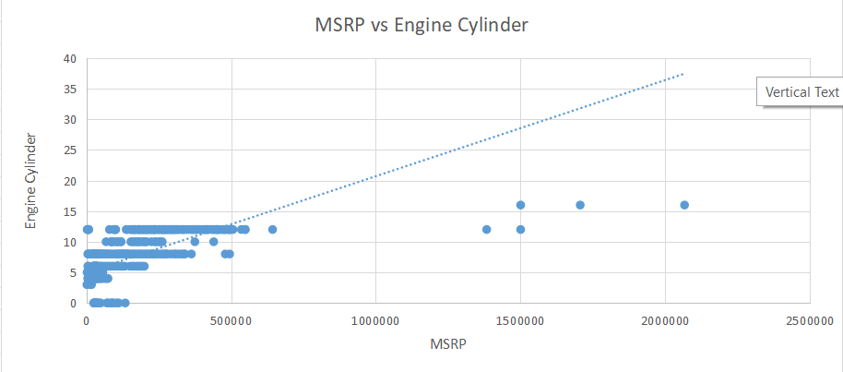
Insight Required: Which car features are most important in determining a car's price?
Task 3: Use regression analysis to identify the variables that have the strongest relationship with a car's price. Then create a bar chart that shows the coefficient values for each variable to visualize their relative importance.
Ans:As we have to perform regression analysis with the dependent variable 'MSRP', we cannot perform regression analysis on categorical values. Therefore, we performed regression analysis based on numerical values, and found that the Engine hp & Engine cylinder has the strongest moderate relationship with MSRP. We plotted a bar graph of Engine hp vs price, and found that it is a car feature that we can include to make the car more appealing.

Slide 8
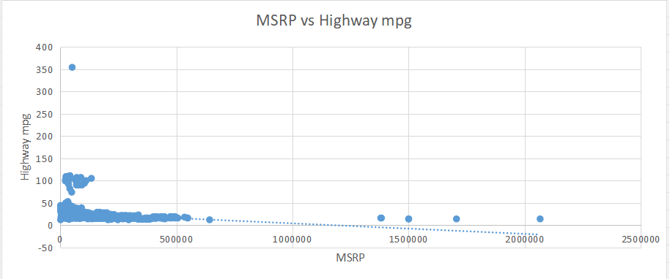
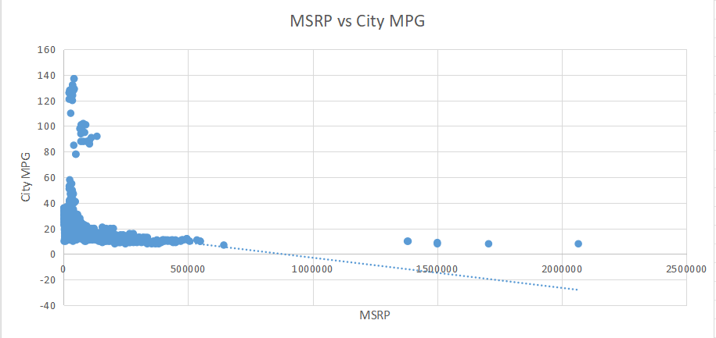
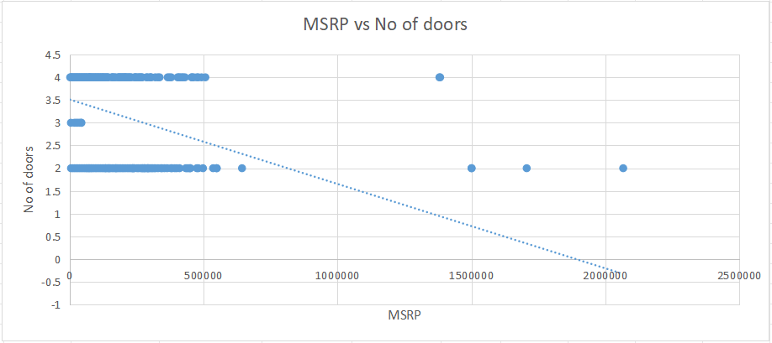

Slide 9
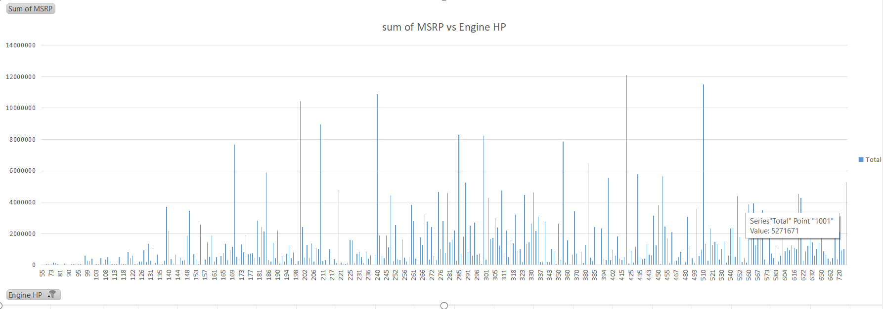

Slide 10
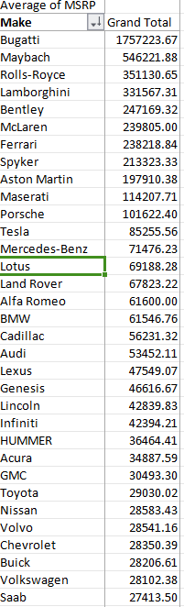
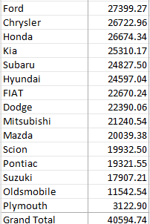
Insight Required: How does the average price of a car vary across different manufacturers?
Task 4.A: Create a pivot table that shows the average price of cars for each manufacturer.
Ans:

Slide 11
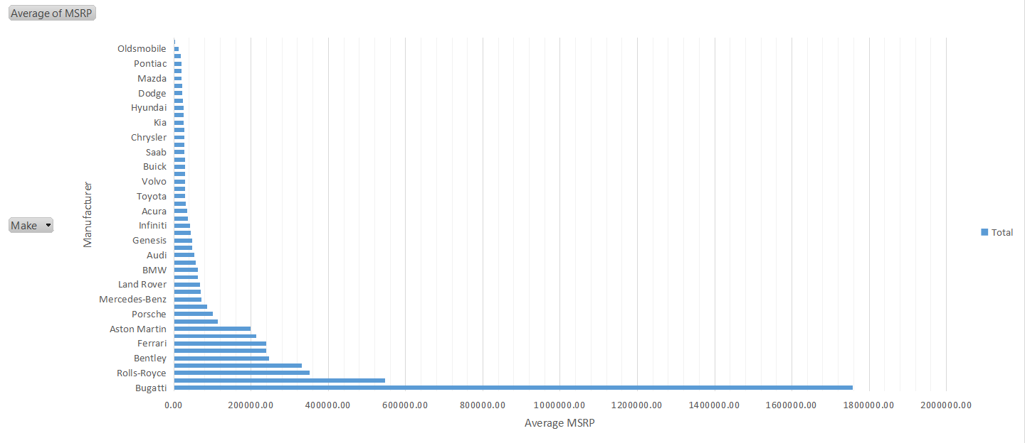
Task 4.B: Create a bar chart or a horizontal stacked bar chart that visualizes the relationship between manufacturer and average price.
Ans:

Slide 12
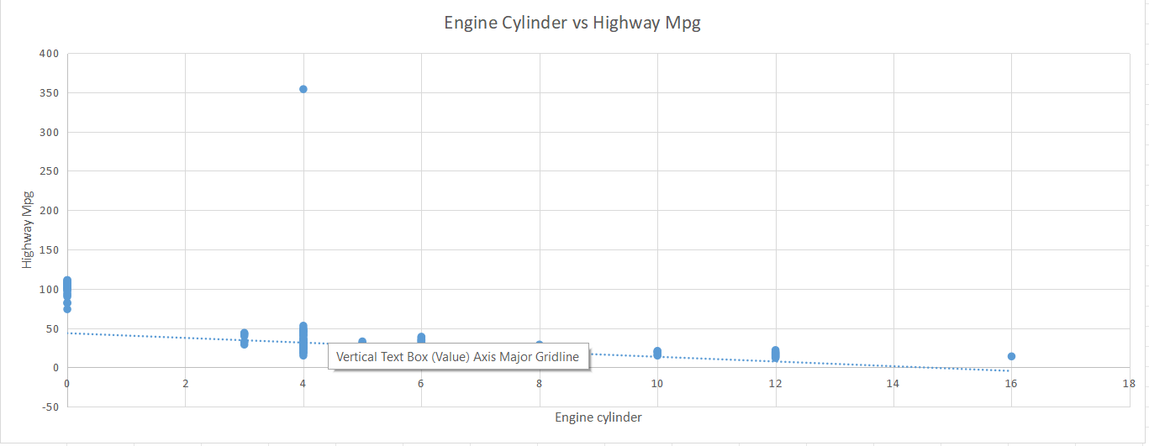
Insight Required: What is the relationship between fuel efficiency and the number of cylinders in a car's engine?
Task 5.A: Create a scatter plot with the number of cylinders on the x-axis and highway MPG on the y-axis. Then create a trendline on the scatter plot to visually estimate the slope of the relationship and assess its significance.
Ans:

Slide 13

Task 5.B: Calculate the correlation coefficient between the number of cylinders and highway MPG to quantify the strength and direction of the relationship.
Ans:We can see that there is an indirect relationship between these two variables. As the number of cylinders increases, the highway miles per gallon decreases. This means that as fuel efficiency increases, the number of cylinders decreases.

Slide 14
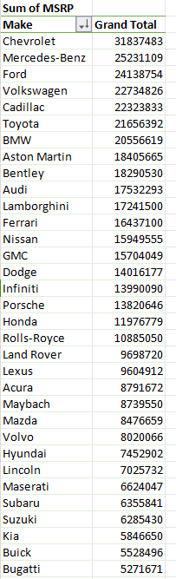
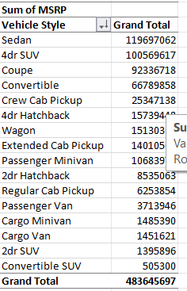
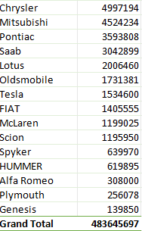
Dashboard Task
Task 1: How does the distribution of car prices vary by brand and body style?
Ans: Total price by manufacturer and style

Slide 15
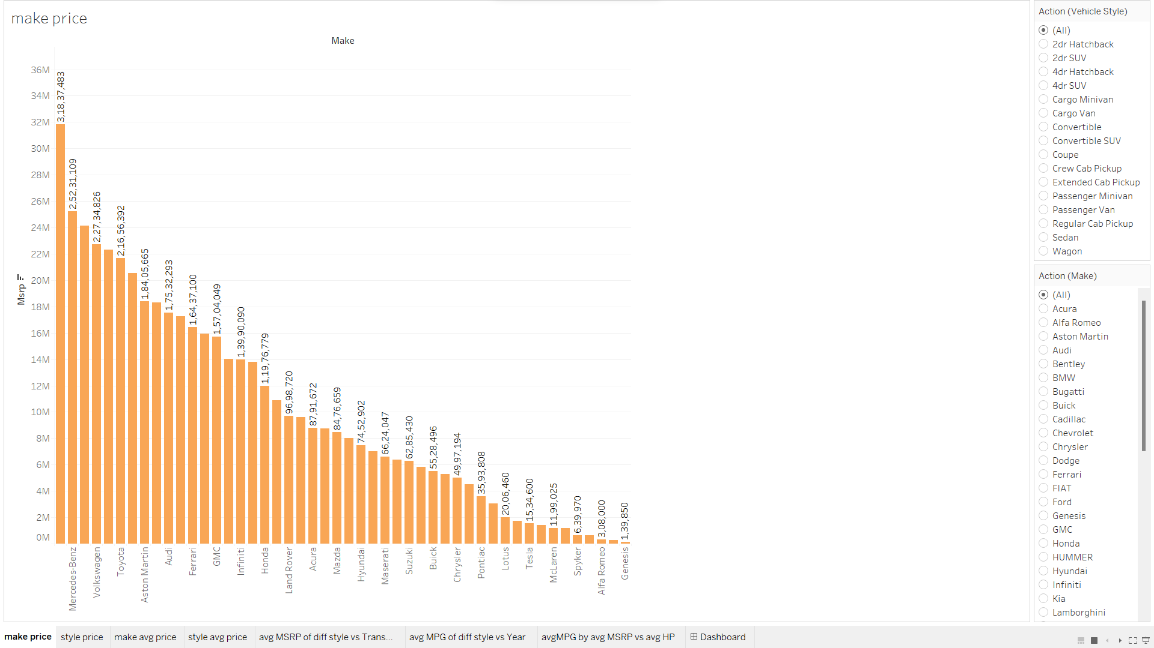
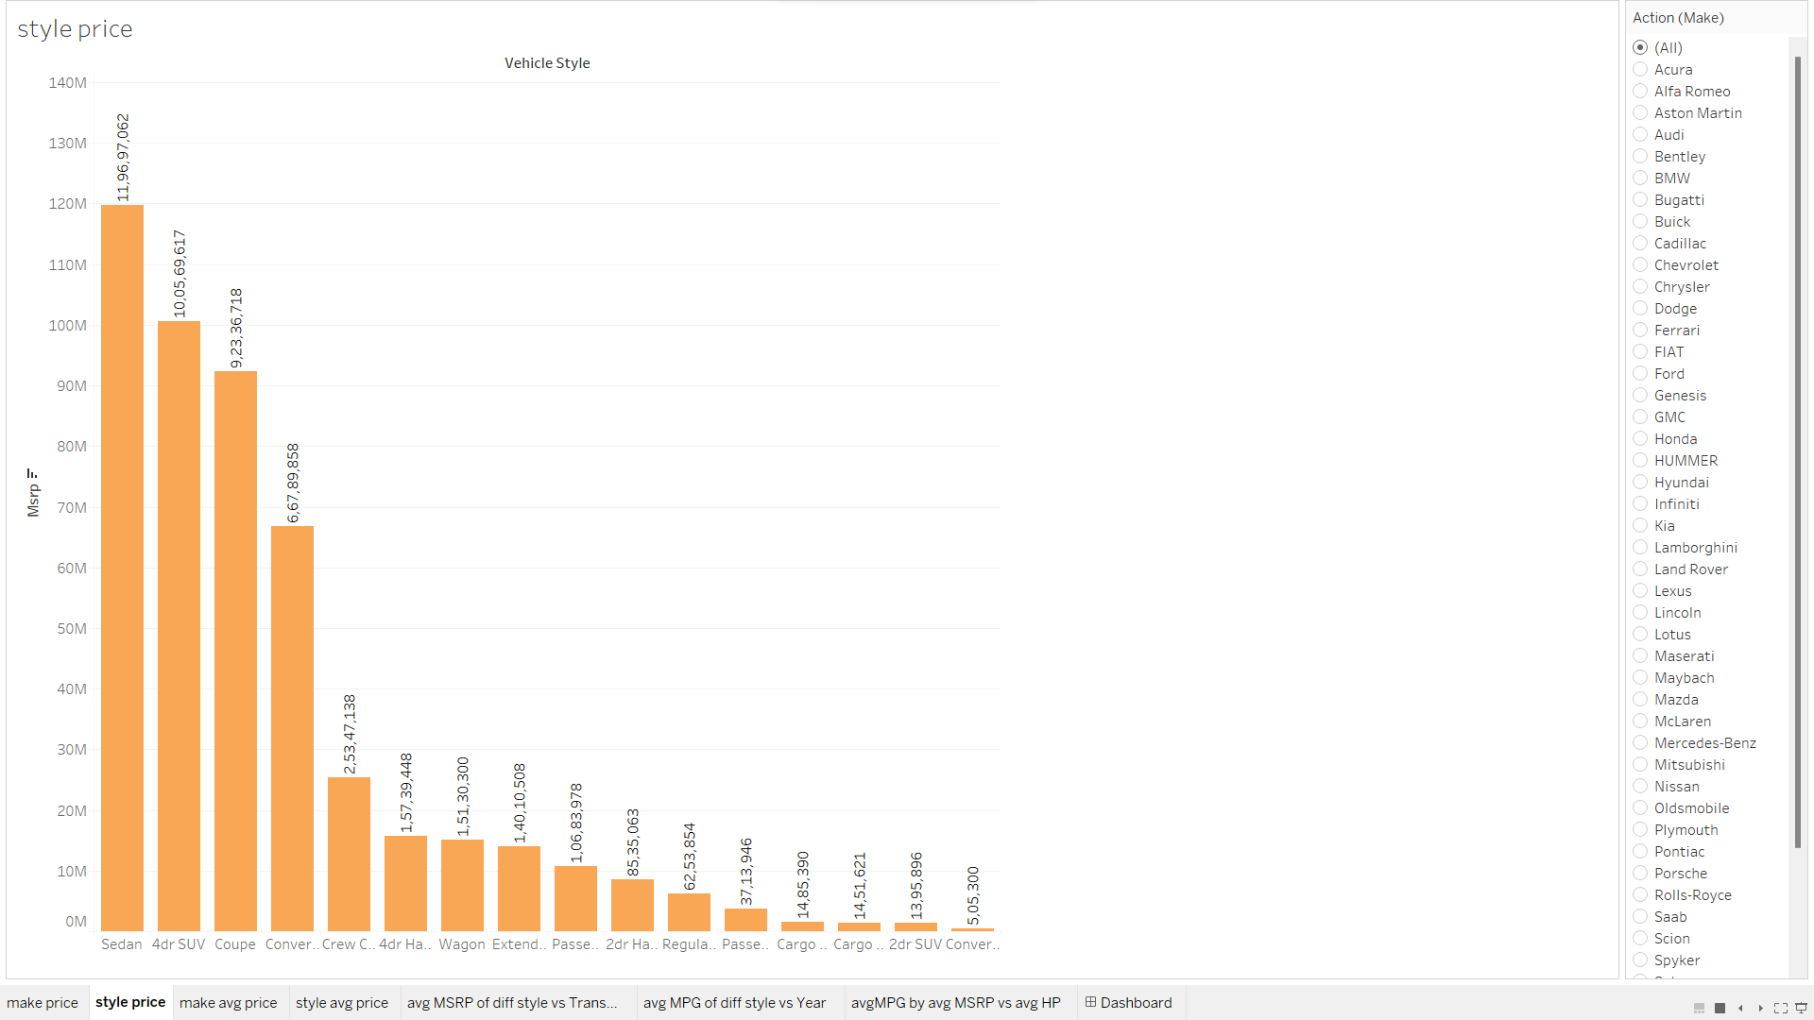

Slide 16
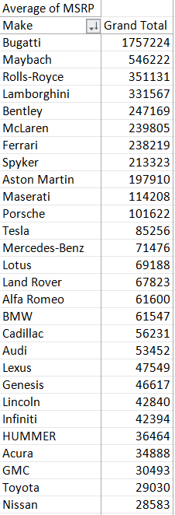
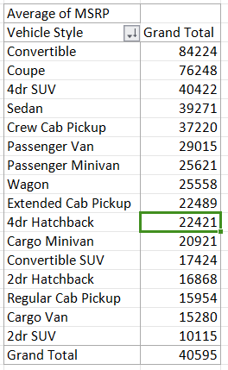
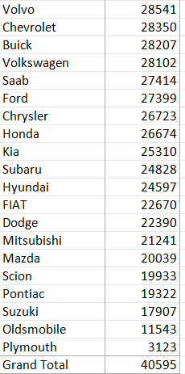
Task 2: Which car brands have the highest and lowest average MSRPs, and how does this vary by body style?
Ans:

Slide 17
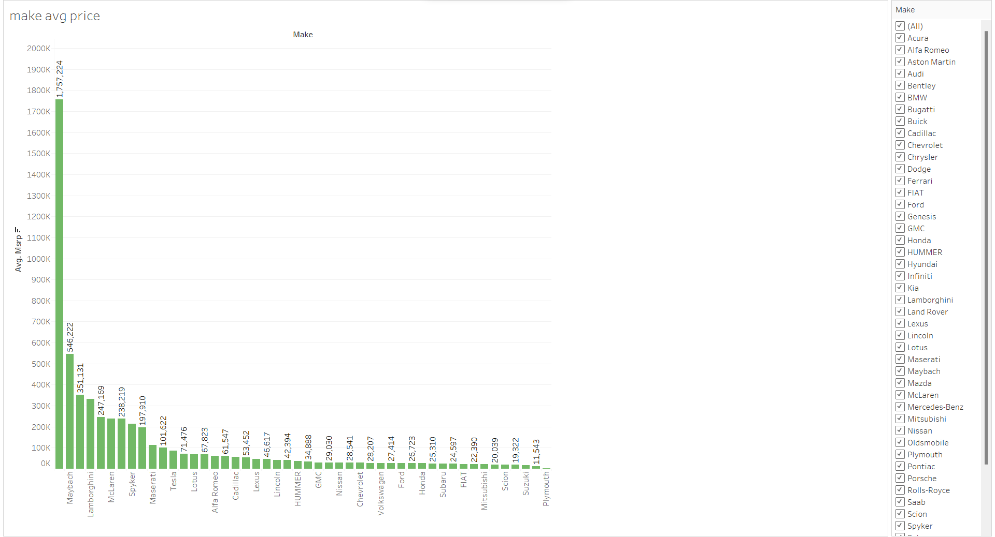
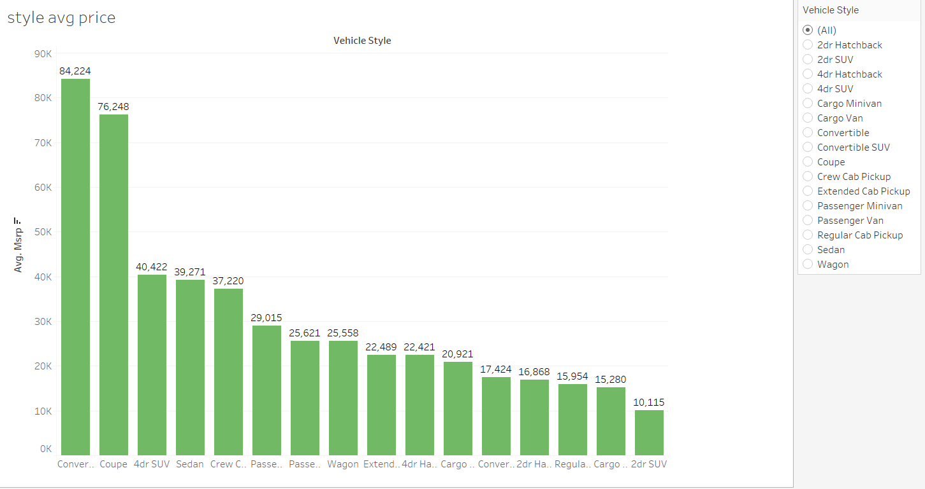

Slide 18
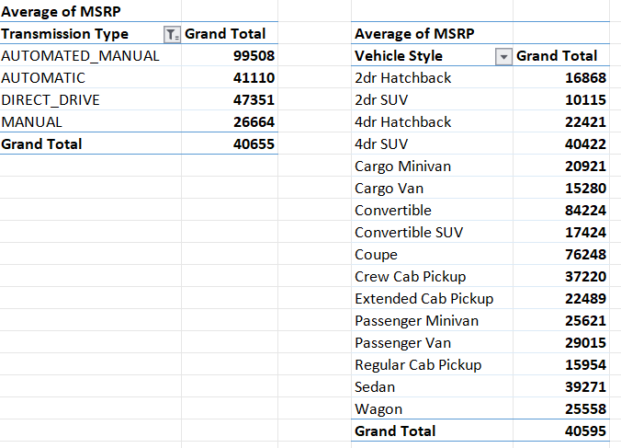
Task 3: How do the different feature such as transmission type affect the MSRP, and how does this vary by body style?
Ans: Average price by Transmission type & style

Slide 19
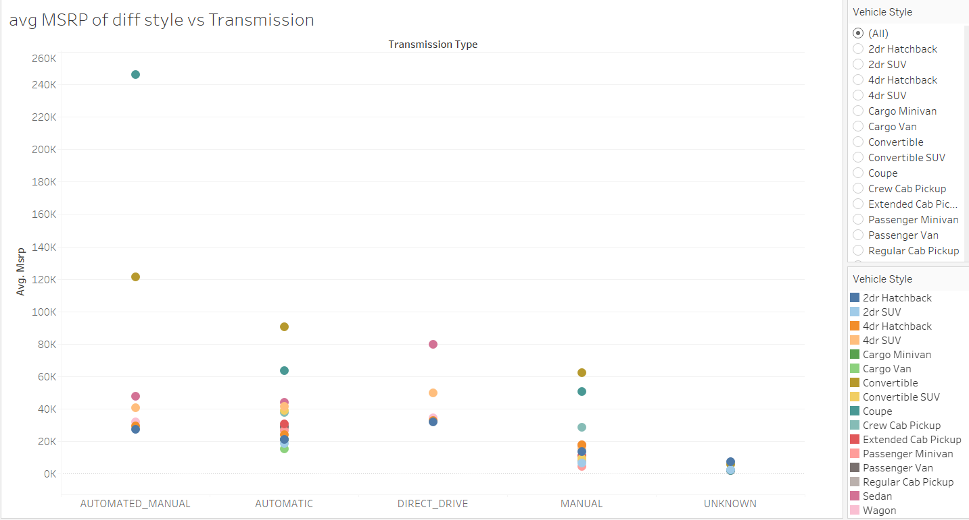

Slide 20
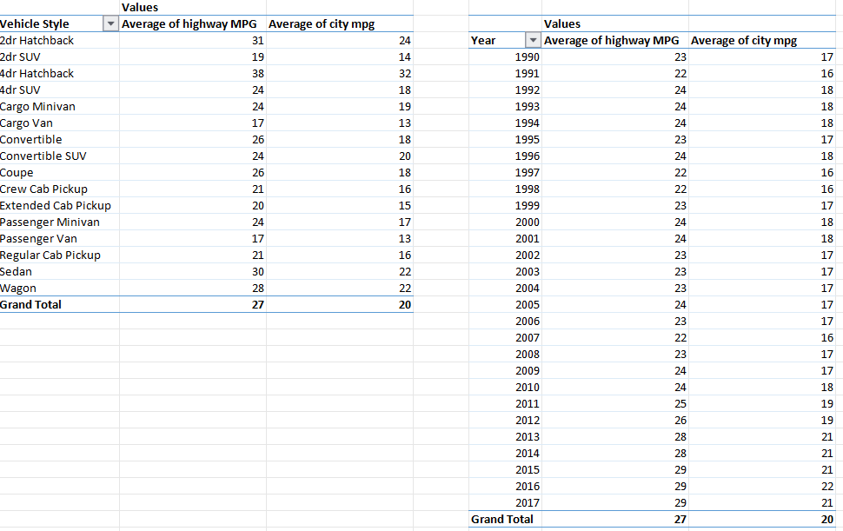
Task 4: How does the fuel efficiency of cars vary across different body styles and model years?
Ans:

Slide 21
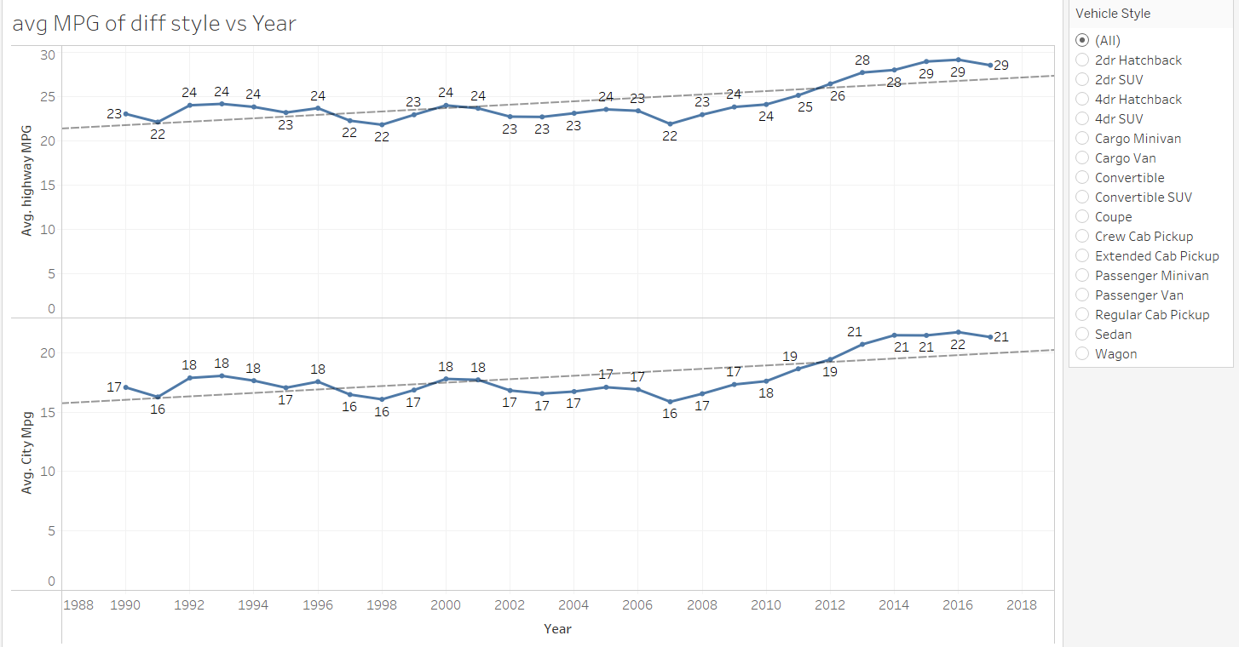

Slide 22
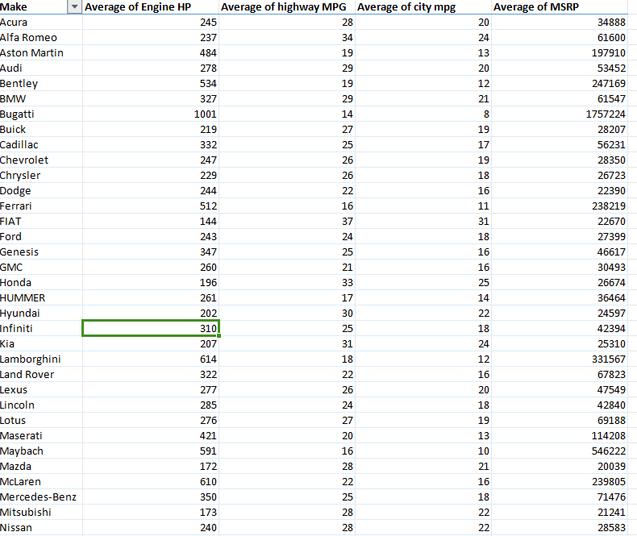
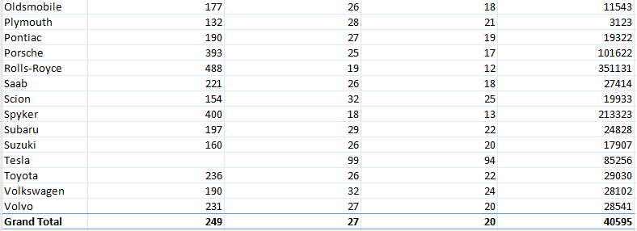
Task 5: How does the car's horsepower, MPG, and price vary across different Brands?
Ans:

Slide 23
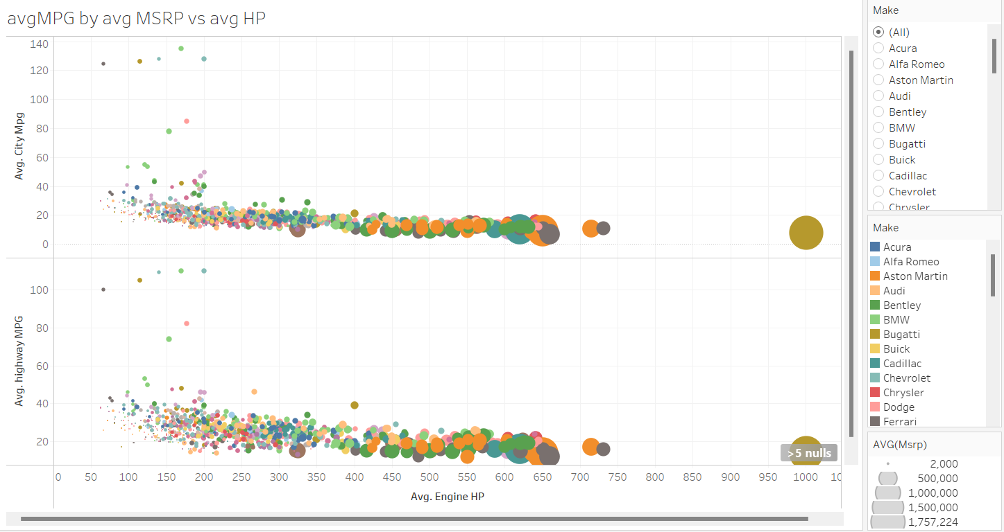

Slide 24
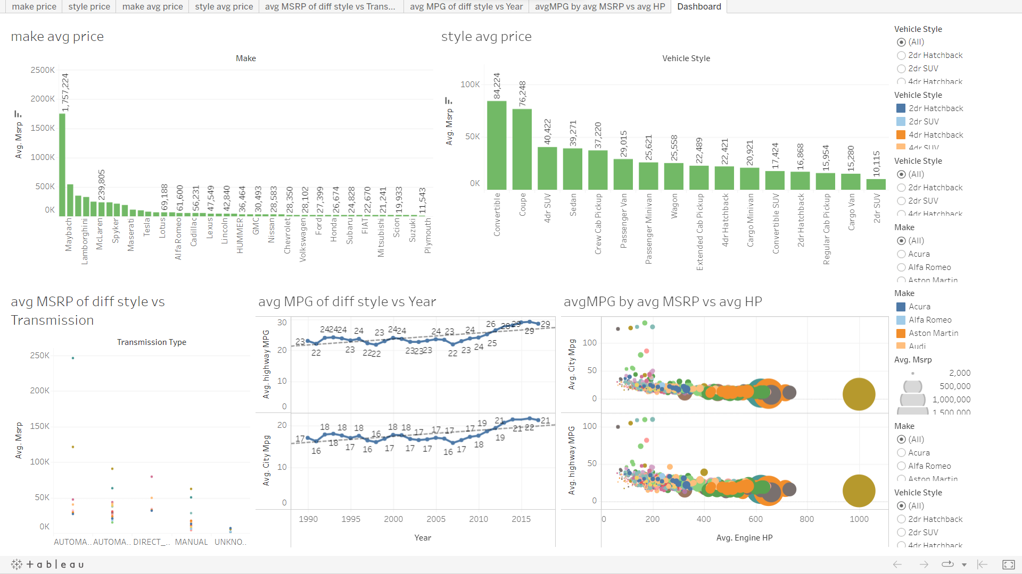
DASHBOARD

Slide 25
INSIGHTS :
In the crossover market category, a high number of models are built, which means people are liking the crossover category more.
The higher the engine hp the higher the price.
The engine cylinder has the strongest relationship with price.
The no of door,Highway mpg & city mpg has a weak relation with price.
Buggati brand car has the higest avg MSRP & plymouth brand car has the lowest avg MSRP.
Fewer engine cylinders give more highway MPG, which can attract customers to buy the car.
Sedan, 4-door SUV, and coupe vehicle styles have high MRP, which we can use to make the car profitable.
Automatic and automatic manual transmissions are loved by customers and can be priced high. From insights, we can see that people are continuously buying them despite their high price, which can be used to make our cars profitable.
New models have high MPG due to modifications .
Sedans and hatchbacks give higher average MPG.
By utilizing the insights , we can make data-driven decisions to optimize the cost and profitability of our cars, as well as establish our position in the car market. This will help us create more appealing and competitive models that attract customers and increase sales.

Slide 26
RESULTS:
Based on the analysis, it appears that the crossover market category are more popular among customers, indicating that more people are buying them at a higher rate.
Sedan, 4-door SUV, and coupe vehicle styles have high MRP, which we can use to make the car profitable.
In the future, as people appreciate vehicles that provide high fuel efficiency at a low cost, electric cars with high mileage and fewer cylinders may be more popular.
We cannot perform regression analysis on categorical values when the dependent variable is a numerical value such as price.
PROJECT LINK:
https://docs.google.com/spreadsheets/d/1R9bB0-1Fg2Hk2-dycRy-kpxHrrUWJ3sQ/edit?usp=drivesdk&ouid=111398243446314990339&rtpof=true&sd=true
Dashboard link:
https://public.tableau.com/views/caranalysis_16932099114040/Dashboard?:language=en-US&publish=yes&:display_count=n&:origin=viz_share_link

Slide 27
Thank You

